Slide 1
World Agricultural Outlook Board
Interagency Commodity Estimates Committee Forecasts
Lockup Briefing
August 12, 2015

Slide 2
World Wheat Production

Slide 3

Daily MinAg data indicate that spring grain planting was complete by June 18, with sown area down less than 1% from last year despite rain-related delays.
Post warns that 15-20% of the reported sown area in North Kazakhstan oblast was actually left unplanted due to wet weather and insufficient machinery.
Source: Ministry of Agriculture

Slide 4
World Wheat Supply and Use

Slide 5
U.S. Wheat Supply and Demand

Slide 6
World Rice Production

Slide 7
World Rice Supply and Use

Slide 8
U.S. Rice Supply and Demand
Rough Equivalent of Rough and Milled Rice

Slide 9
World Corn Production

Slide 10
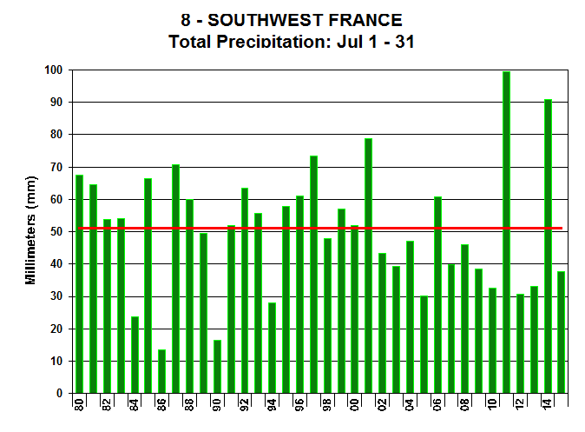
July Rainfall Ranking
July Total Rainfall
In southwest France, it was not quite historically dry, but still drier than normal. The issue here was more the heat.
Avg
2015

Slide 11
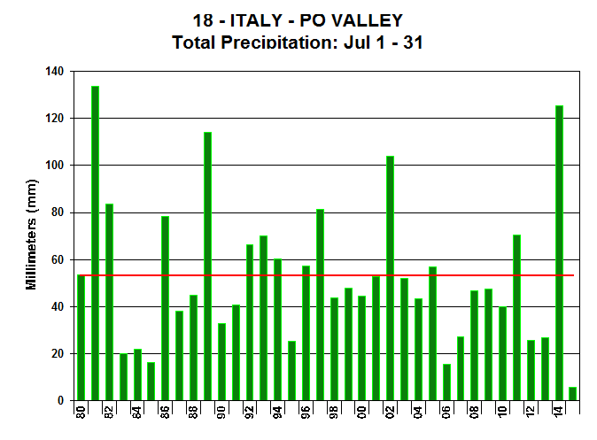
July Rainfall Ranking
July Total Rainfall
In northern Itay, it was the driest July on average going back to 1980.
Avg
2015

Slide 12
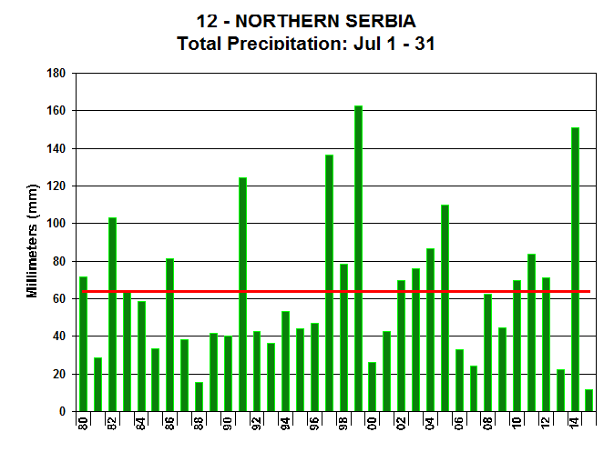
July Rainfall Ranking
July Total Rainfall
Likewise, the driest July on average going back to 1980 in northern Serbia.
Avg
2015

Slide 13
World Corn Supply and Use

Slide 14
U.S. Corn Supply and Demand

Slide 15
World Soybean Production

Slide 16
U.S. Soybean Supply and Demand

Slide 17
World Cotton Production

Slide 18
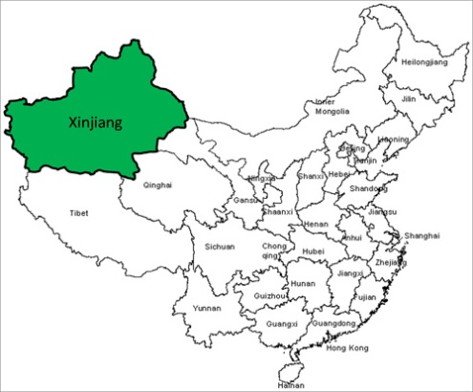
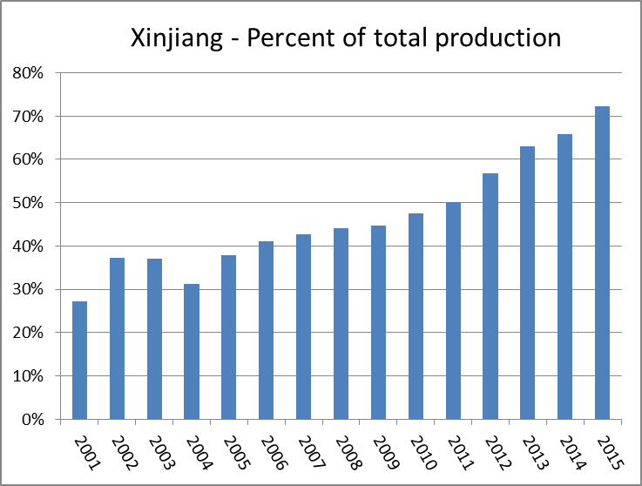
Percent of total China cotton grown
in Xinjiang has been rising. It is now approximately 72 percent.
USDA/FAS/OGA

Slide 19
World Cotton Supply and Use

Slide 20
U.S. Cotton Supply and Demand

Slide 21
U.S. Sugar Supply and Demand

Slide 22
Mexico Sugar Supply and Demand

Slide 23
U.S. Meat Production and Prices

Slide 24
U.S. Meat Trade
Million Pounds

Slide 25
U.S. Milk Supply and Demand

Slide 26
U.S. Dairy Product Prices

Slide 27
U.S. Production Summary

Slide 28
Domestic Demand Summary

Slide 29
U.S. Export Summary

Slide 30
Price Summary

